Slide 1
Employee Data Analysis using Excel
STUDENT NAME: V.VINODHA
REGISTER NO: 312208433
DEPARTMENT: B.COM(ACCOUNTING &
FINANCE)
COLLEGE: CHELLAMMAL WOMEN’S
COLLEGE

Slide 2

Employee Performance Analysis
using Excel

Slide 3

Problem Statement
Project Overview
End Users
Our Solution and Proposition
Dataset Description
Modelling Approach
Results and Discussion
Conclusion

Slide 4

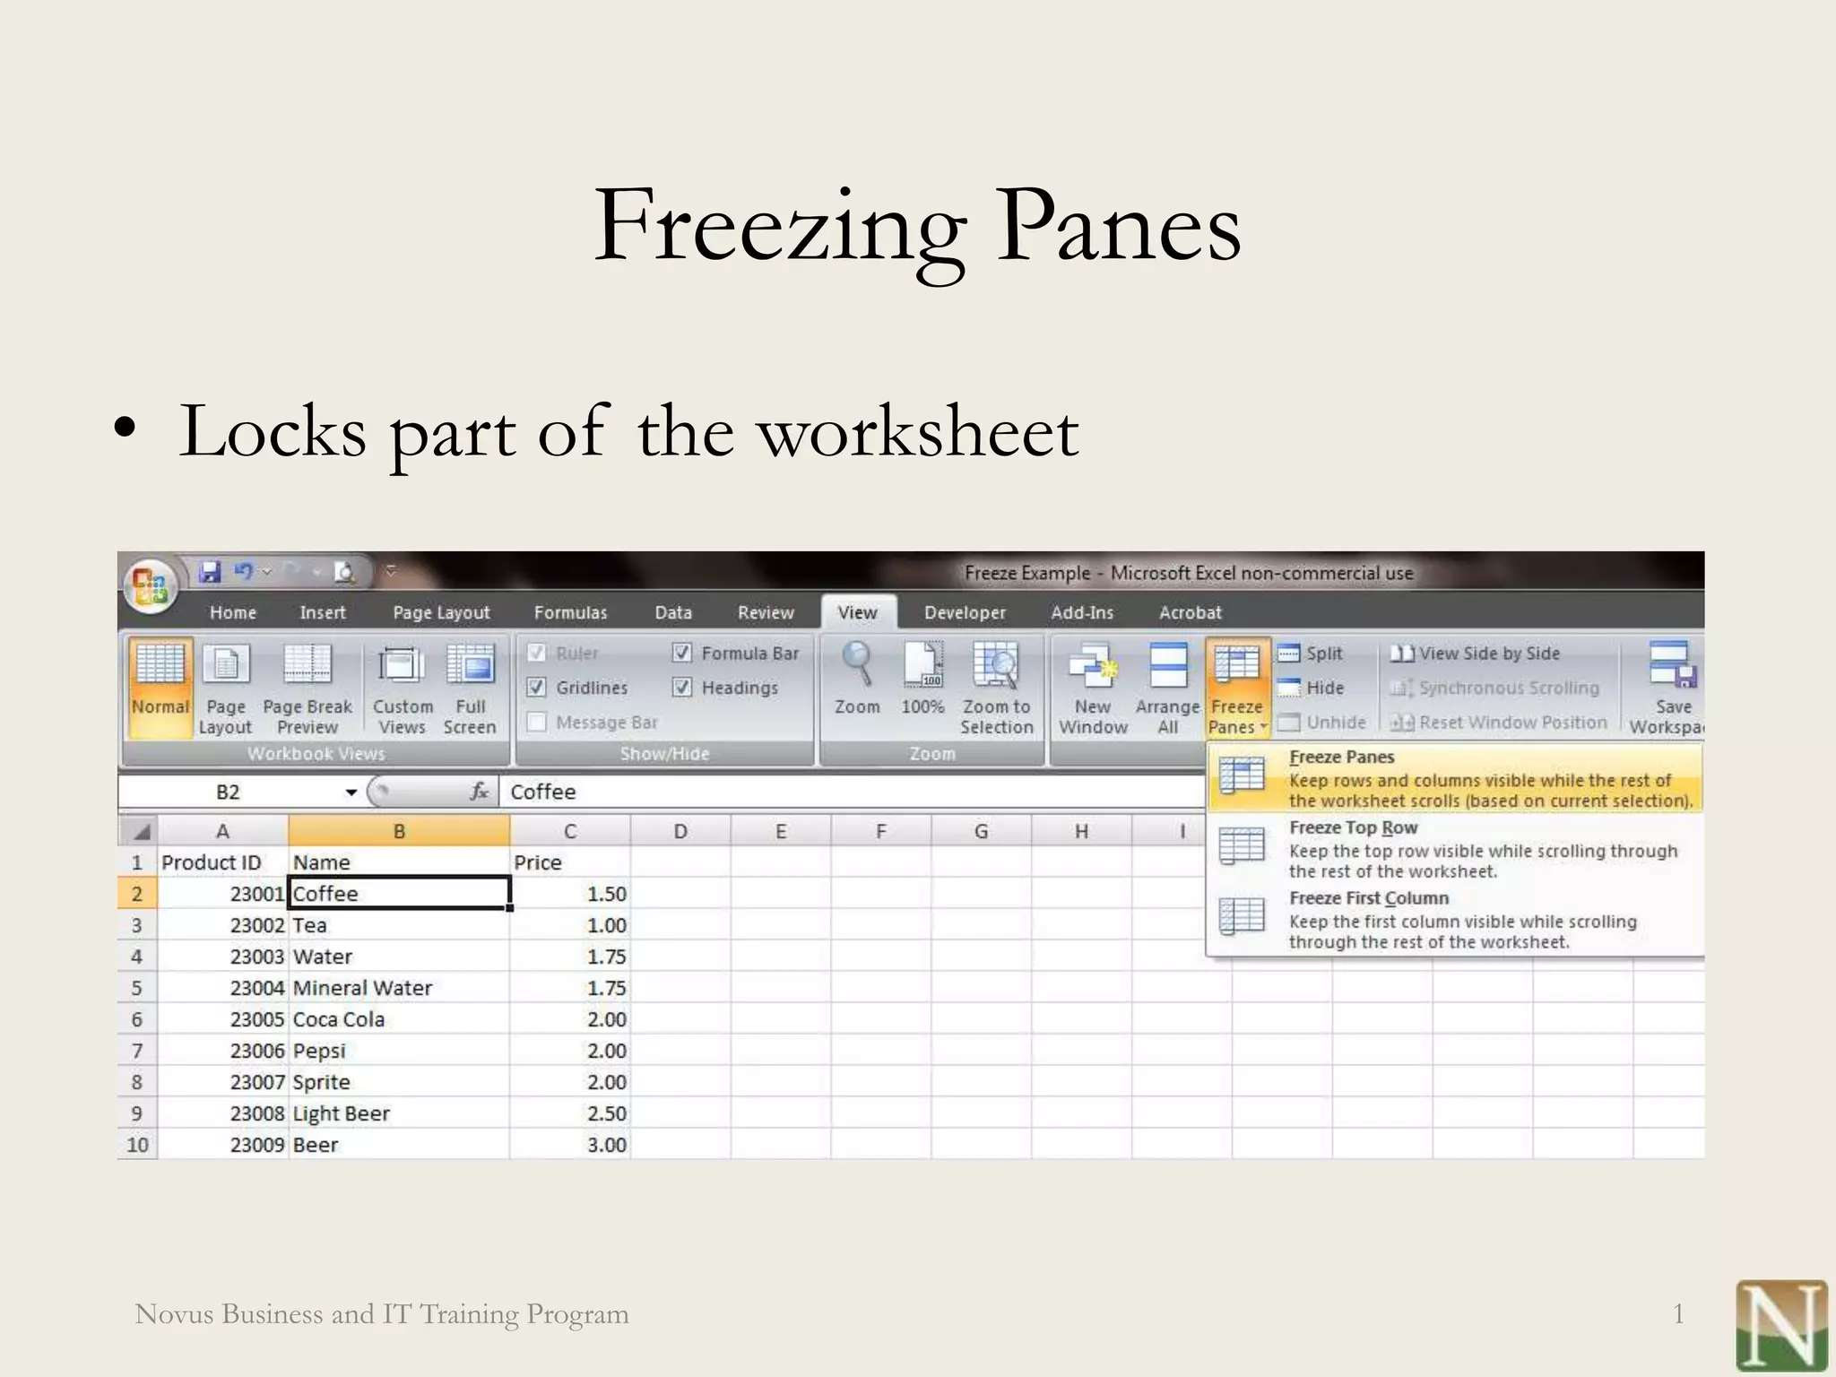

Slide 5

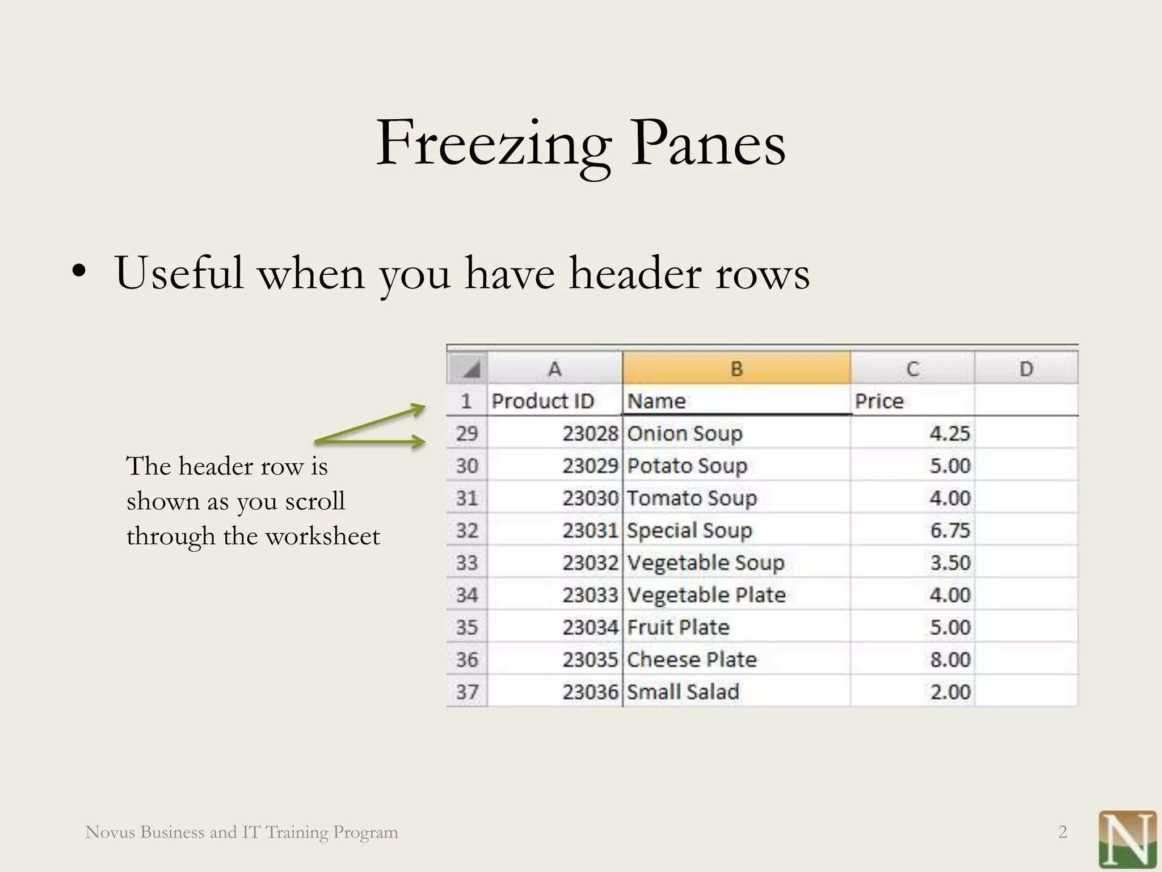

Slide 6

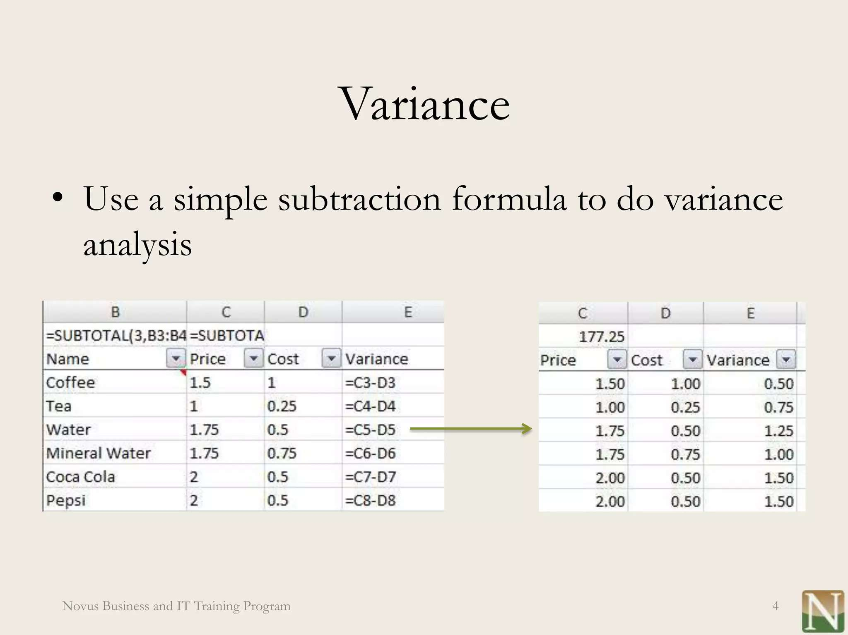
OUR SOLUTION AND ITS VALUE PROPOSITION

Slide 7
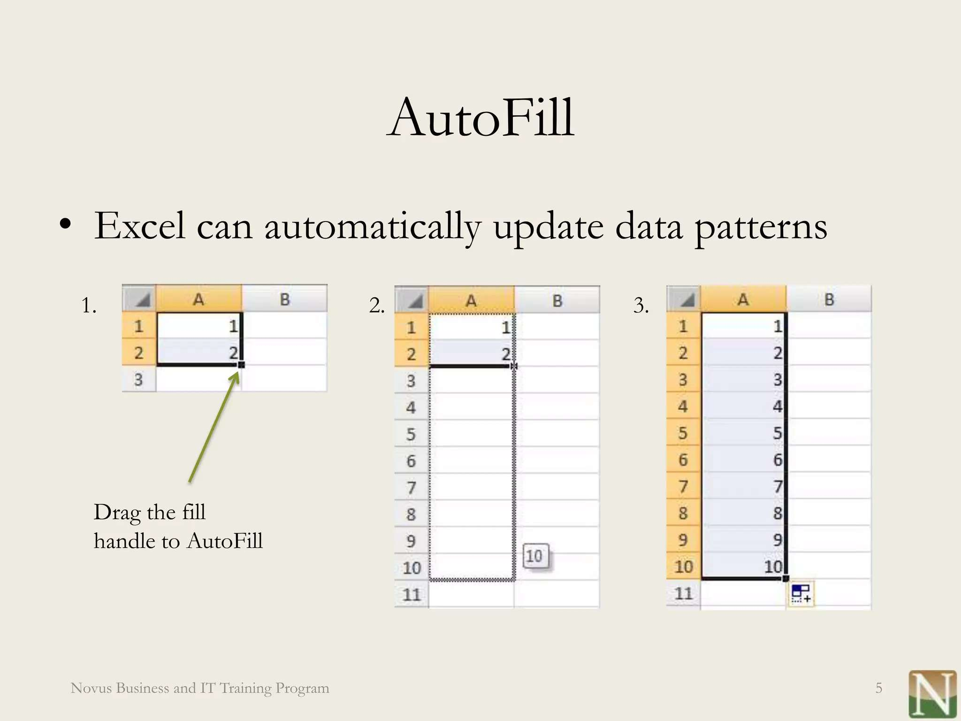
MODELLING

Slide 8
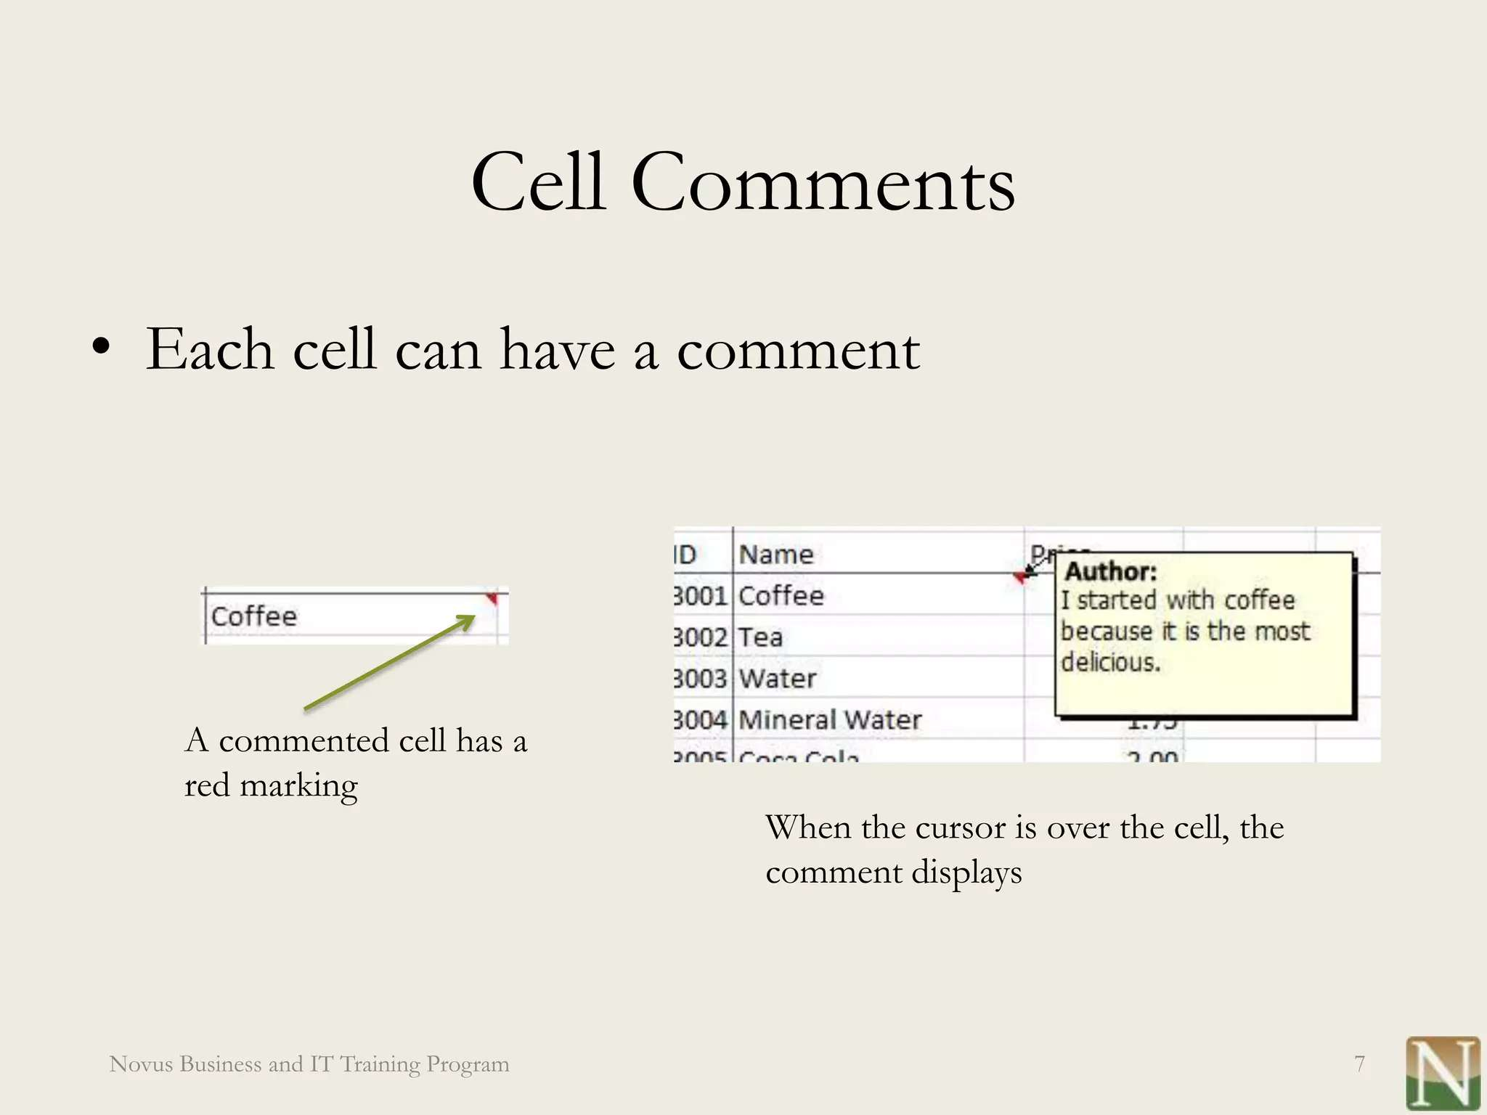

Slide 9
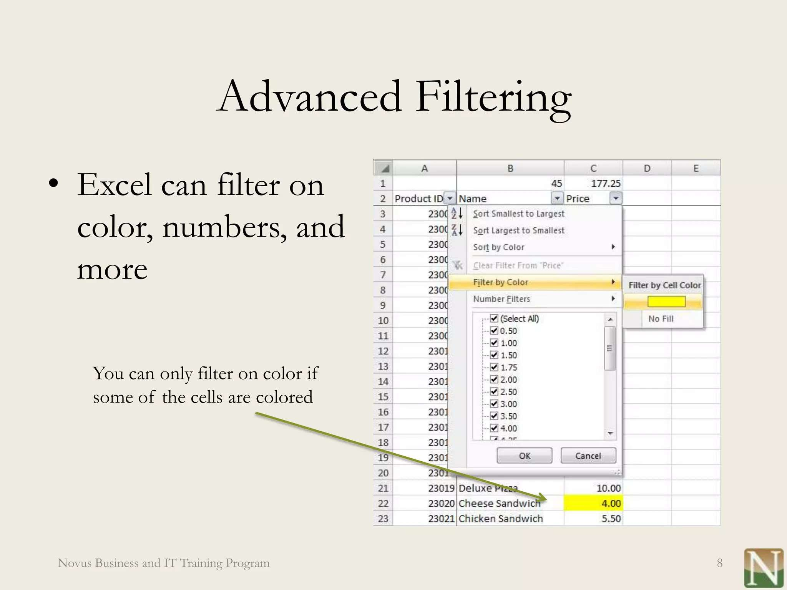

Slide 10
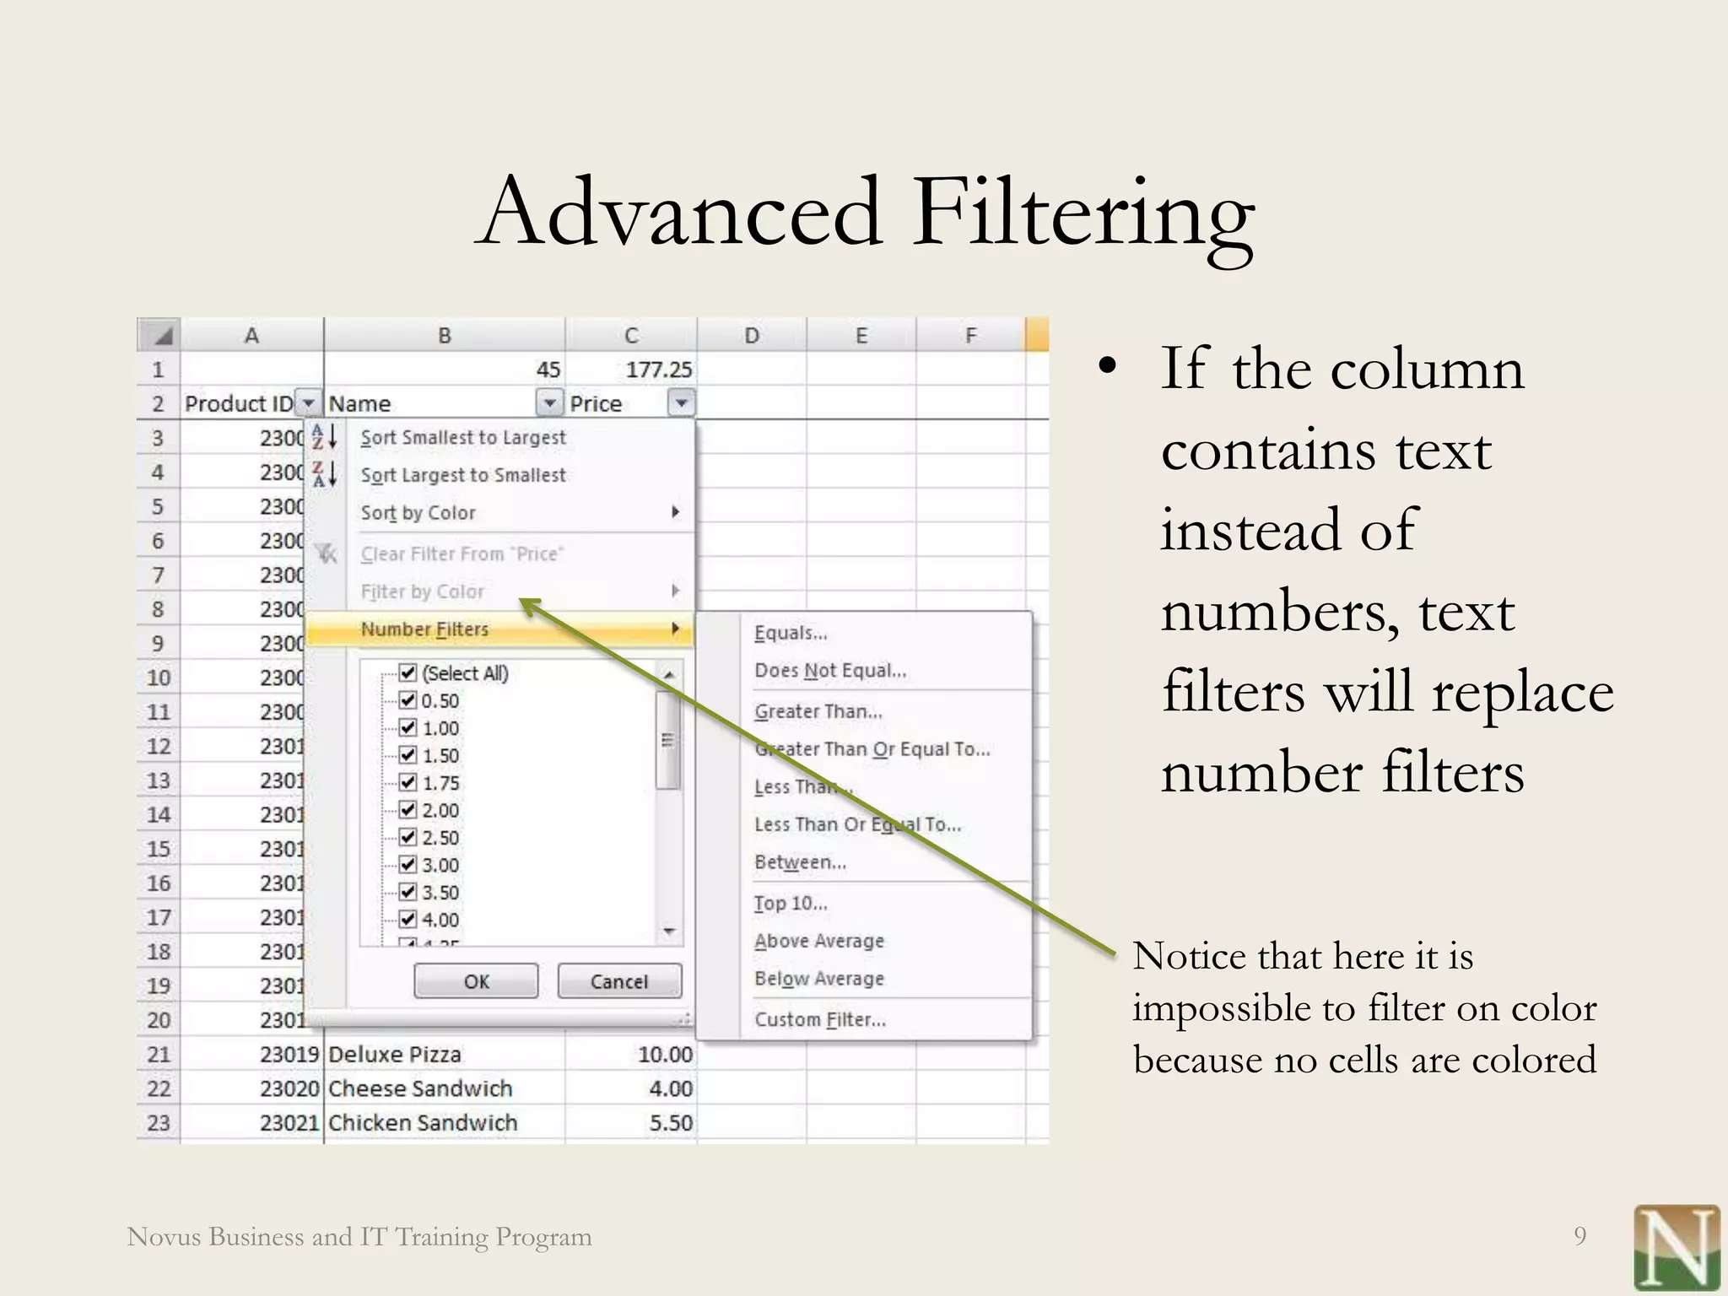
RESULTS

Slide 11
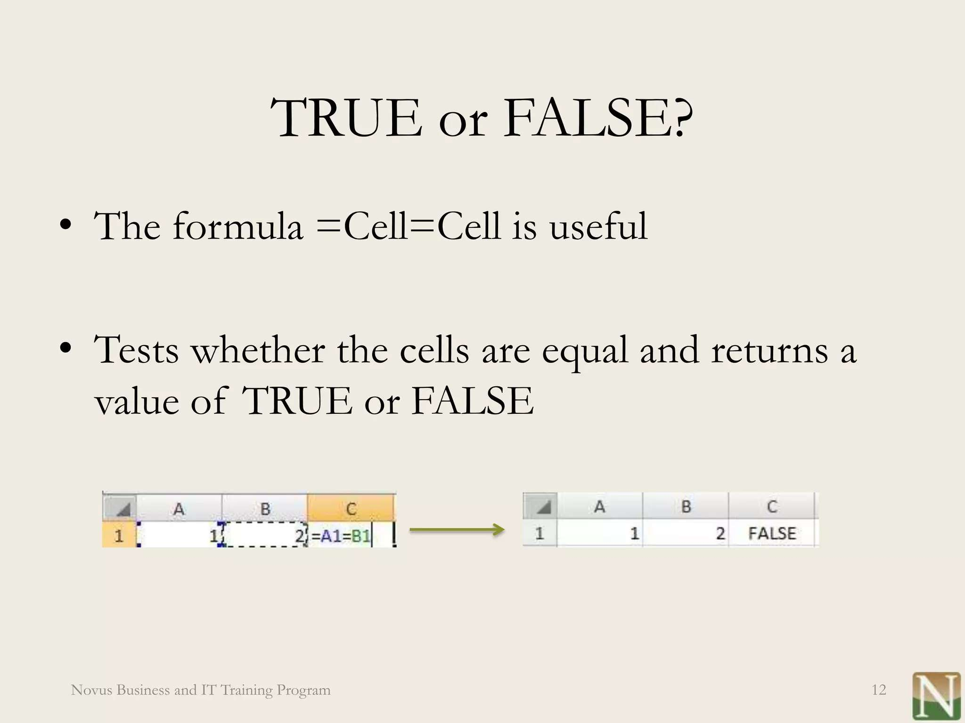

Slide 12
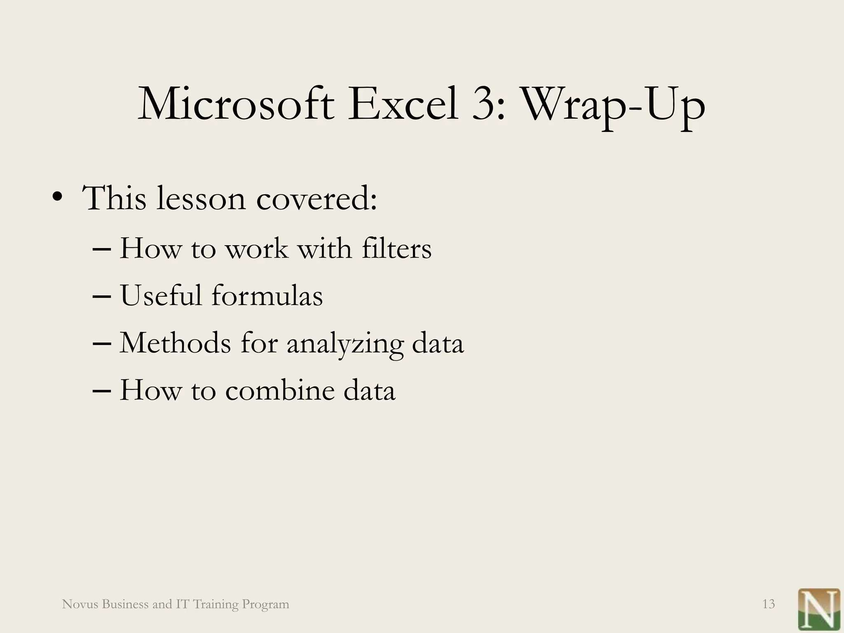

Slide 13
THANKYOU

